Slide 1
can money buy happiness? Raj Raghunathan Austin, TX
Cafemutual Confluence, Mumbai, Sept 20th, 2016
Notes:
As prem mentioned, I am in the b-school, and I teach a course on happiness and even have a book on the topic.
People are surprised that a B-school Prof is teaching a course on happiness.
But I won’t focus on that question; instead I’ll focus on another question: The Genie question. It goes like this…

Slide 2
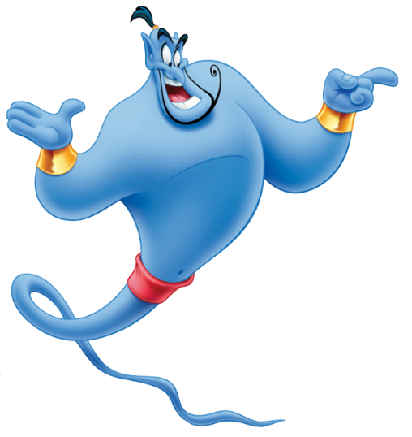
The Genie Question

Slide 3
What’s on people’s Genie wish-list?

Slide 4
What’s on people’s Genie wish-list?

Slide 5
Money and happiness: Expected relationship

Slide 6
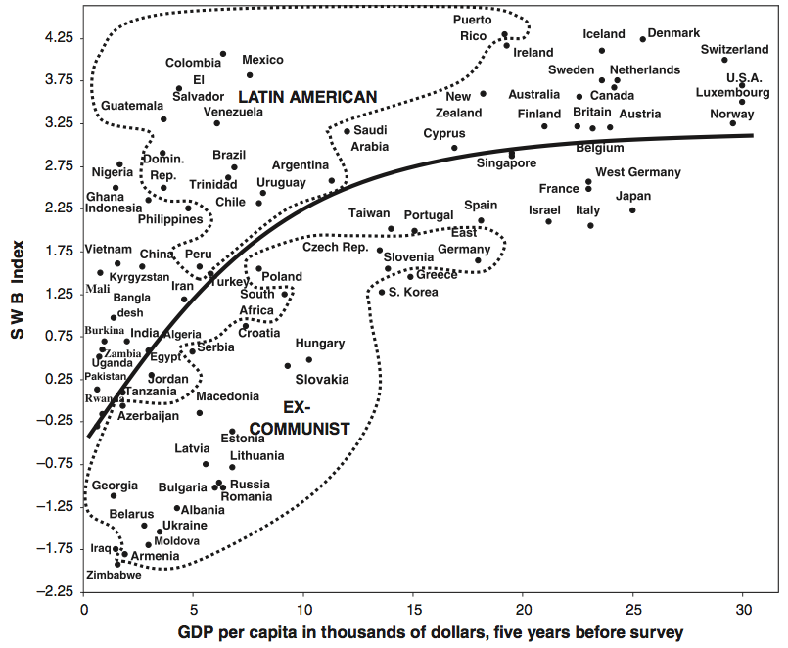
Money and happiness: Country level

Slide 7
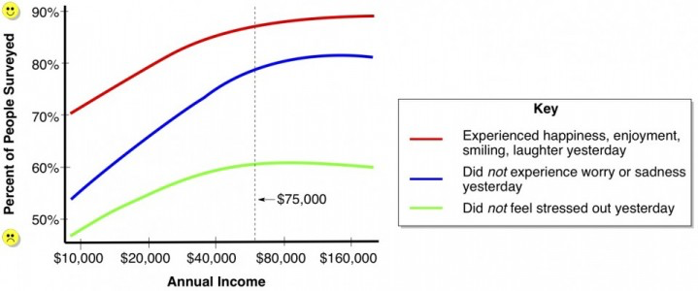
Money and happiness: Individual level

Slide 8
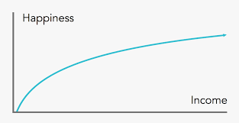

Slide 10
3 tips for spending money right
Notes:
Thought experiment

Slide 11
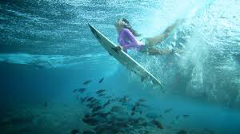
3 tips for spending money right
Tip #1: Buy experiences (vs. material goods)

Slide 12
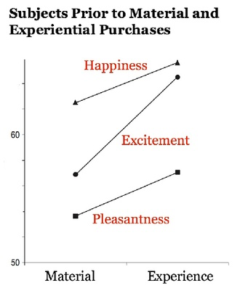
Experiences vs. material goods and happiness

Slide 13
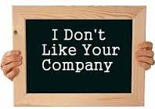
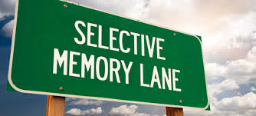
Why experiences > material goods

Slide 14
3 tips for spending money right
Tip #1: Buy experiences
Tip #2: Buy time

Slide 15
Time scarcity/abundance and happiness

Slide 16
Top 7 most hated activities
#7: Cooking
#6: Cleaning house
#5: Getting desk organized
#4: Doing dishes
#3: Child care
#2: Commuting
#1: Dealing with toxic boss/colleague

Slide 17
Top 7 most hated activities
#7: Cooking
#6: Cleaning house
#5: Getting desk organized
#4: Doing dishes
#3: Child care
#2: Commuting
#1: Dealing with toxic boss/colleague

Slide 18
3 tips for spending money right
Tip #1: Buy experiences
Tip #2: Buy time
Tip #3: Invest in others

Slide 19
Unsung hero

Slide 20
The “need to love”

Slide 21
Why investing in others enhances happiness

Slide 22
Summary
Whether money buys happiness depends—on how you spend it
3 ways to make money really work for you (and increase happiness):
Buy experiences (vs. material goods)
Buy time
Invest in others

Slide 23
Thank you!

